Slide 1

Office Rental Service
Capstone Project Defense
Supervisor: Mr. Nguyễn Trọng Tài
Members : Lê Xuân Tiến
Nguyễn Vũ Hoàng Quốc
Trương Tiến Thành
Trần Lê Tuấn

Slide 2
Contents
Current Situation
Proposed Solution
Project Features
Search Office - Request Appointment - Create Contract
Request Office
Extend and Return contract
Request Rental/ Repair
Statistic and Management
Pros and Cons
Future Development
Notes:
Chia lại luồng search – appointment, accept – contract - extend contract, Repair request,

Slide 3
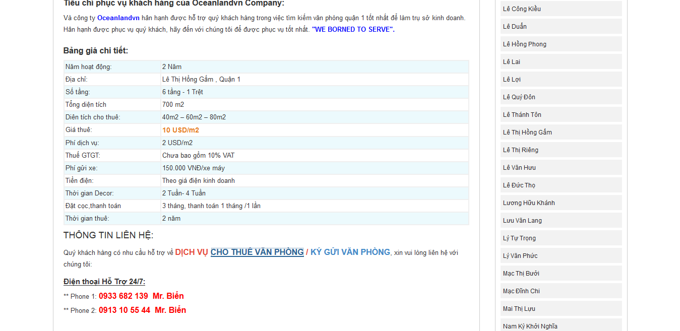
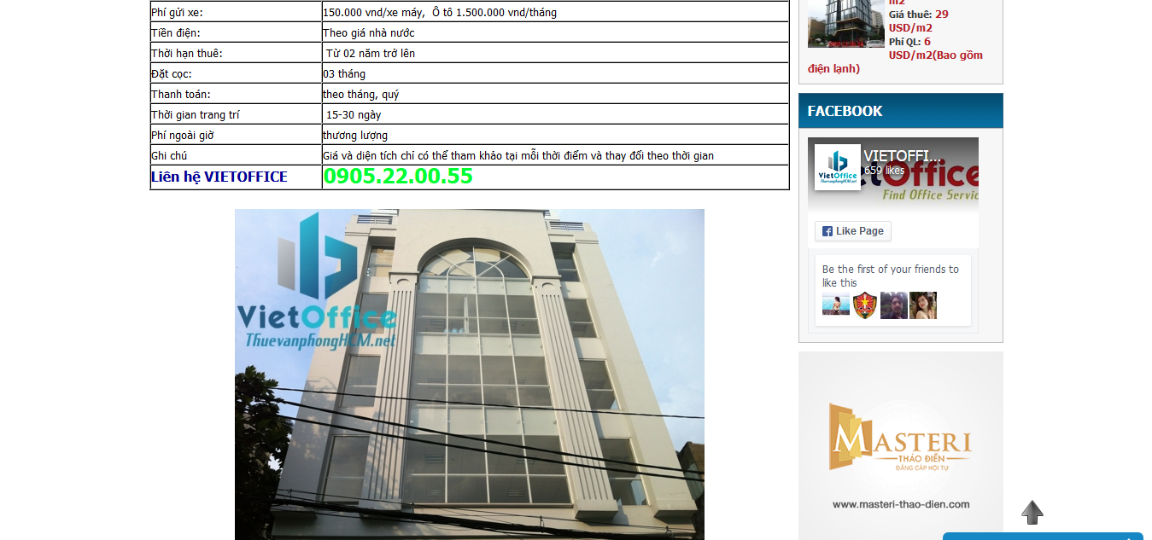
Current Situation
There are a lot of office rental websites in Vietnam but most of those websites only provide information of offices.
Lack of customer service.
Managing contracts manually.
http://vanphonggiatotchothue.com
http://www.vanphongchothuequan1.com.vn
Notes:
customer service: appointment, rental and repair service

Slide 4






Proposed Solution
Contact with
Manager
Owner
Manage
Belong to
Contact with
System
Customer
Assign
Office
Contact with
Staff
Notes:
customer service: appointment, rental and repair service

Slide 5
ORS’s Advantage
Find suitable office
Easy to sign contract
Easy to create appointment
Manage amenities
Owner
Easy to send rental/ repair request
Customer
Manage contract
Can request office

Slide 6
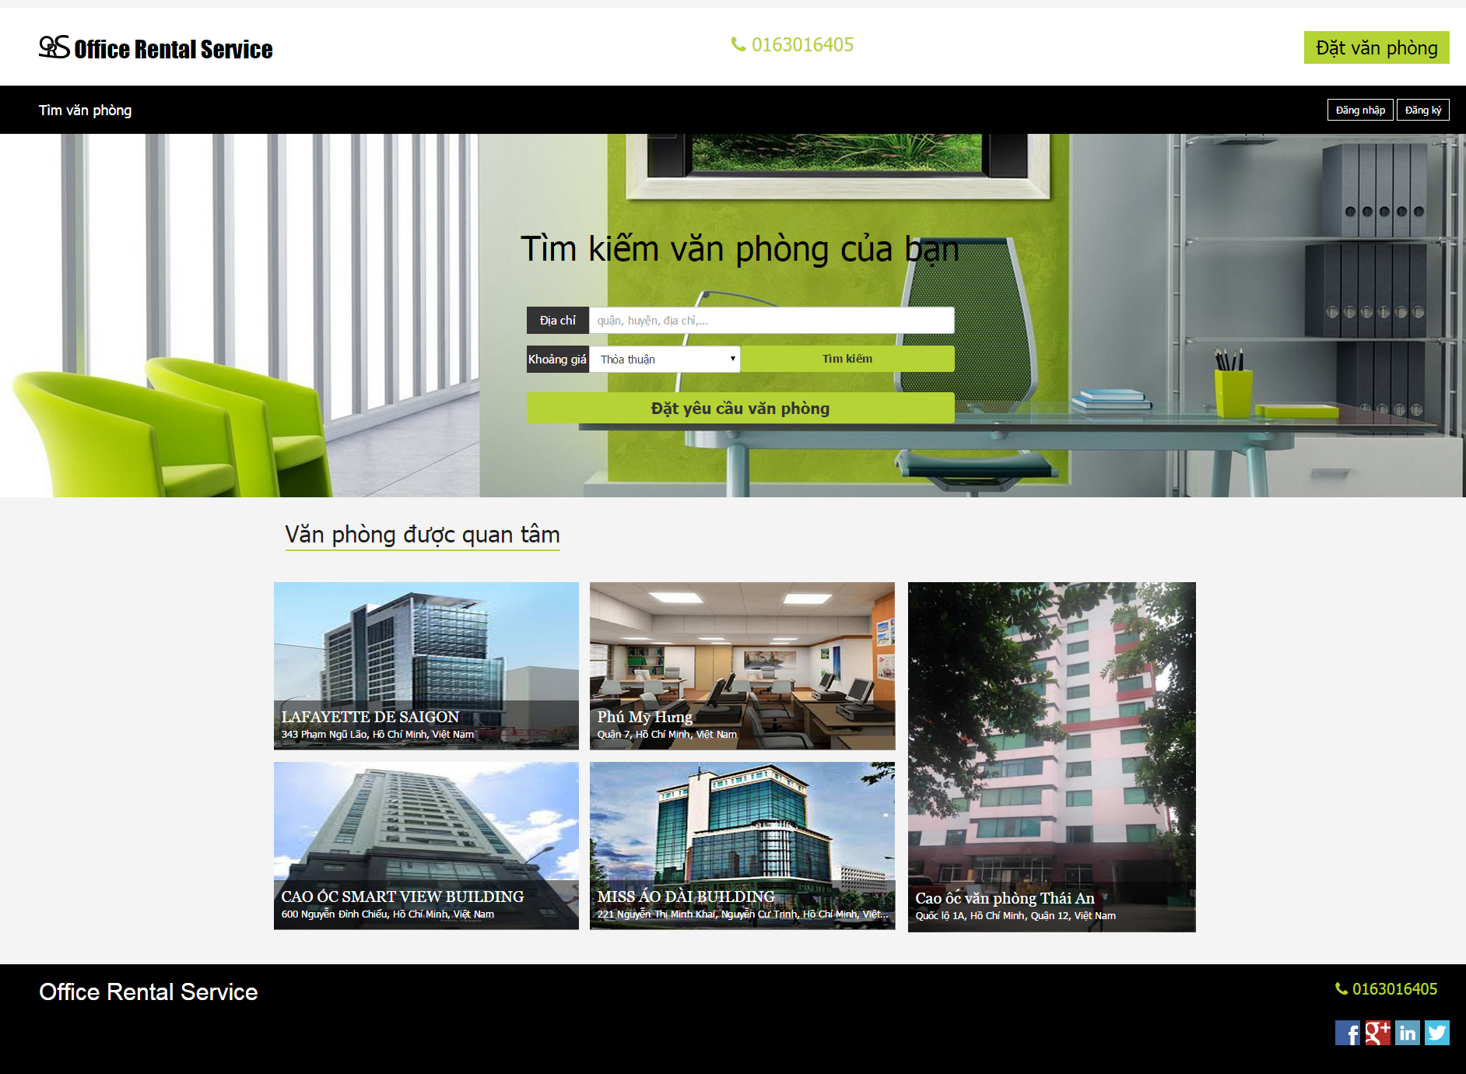
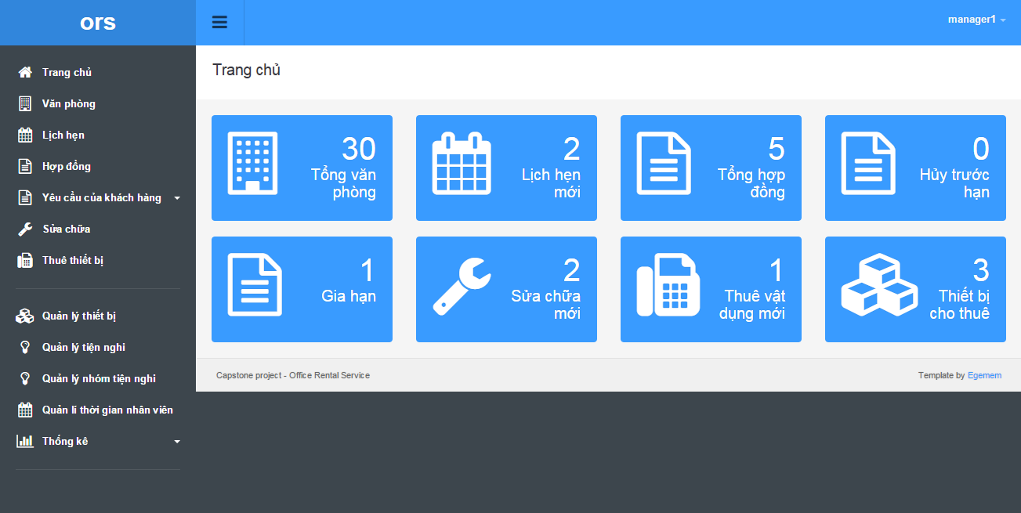
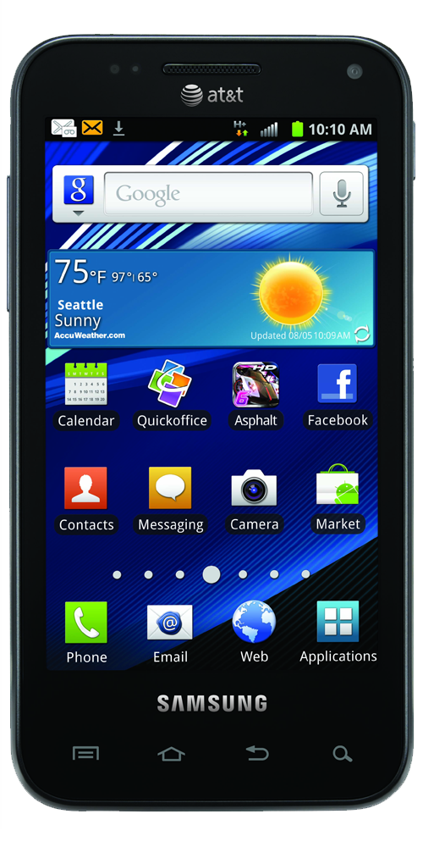
Proposed Solution
Search office
Manage office
Customer
Manager
Request office
Schedule request
Request appointment
Manage appointment
Back office
Website
Staff
Create contract
Manage contract
Request repair/ rental
Manage repair/ rental
Check appointment
Staff
Check assigned request
Mobile

Slide 7

Project Features Search Office - Request Appointment - Create Contract
(5) Meet and check office
(6) Decide create contract
Customer
Staff
(1) Choose an office
(4) Assign to staff
(2) Create appointment
System
(8) Create Contract
Contract
(3) Go to appointment
(7)
Manager

Slide 8
Project Features Request Rental/Repair
(7) Accept/Reject
(6) Meet customer
(7) Done
Staff
Customer
(4) Send SMS
(5) Accept/Reject
(1) Send request
(3) Assign
(2) Check
Manager
System

Slide 9
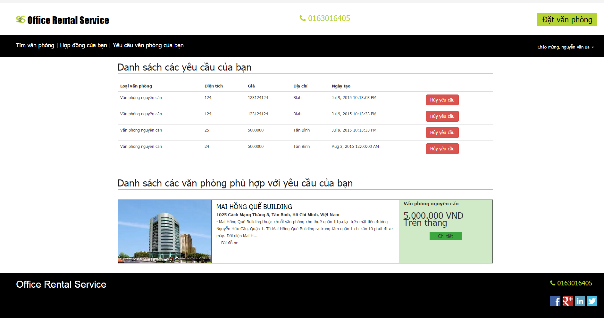


Project Features Request Office
(5) Check request
(1) Create request
Customer
Result page
(2) Schedule check
(4) Send email
System
(3) Return data
Database
Customer’s email

Slide 10
Project Features Extend and Return contract
(1) Send request
Customer
System
(2) Check, then Accept or cancel request
Manager

Slide 11
Project Features Request Rental/Repair
(7) Accept/Reject
(6) Meet customer
(7) Done
Staff
Customer
(5) Send SMS
(4) Accept/Reject
(1) Send request
(3) Assign
(2) Check
Manager
System

Slide 12
Project Features Management
Admin
User

Slide 13





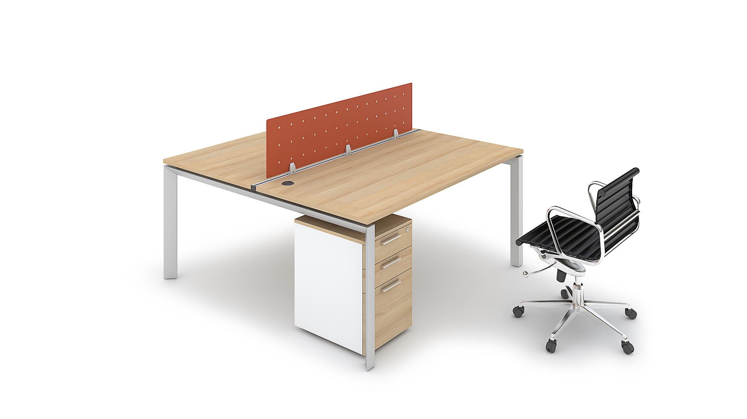
Project Features Management
Request
Appointment
Rental
Manager
Contract
Statistic
Rental item
Amenity

Slide 14
Pros and Cons
Pros:
Providing search engines criteria: price, location, amenities...
Providing full information about the office. Support map for customers.
Making an appointment easily.
Tracking contract easily.
The customer’s requests are automatically suggest by system.
Helping staff easily to manage and update their jobs by mobile application.

Slide 15
Pros and Cons
Cons:
The partner who own the office must contact us to post their information.
The function of notification system is limited.
Only in Ho Chi Minh city.

Slide 16
Future Development
Mobile application provide creating office for staff.
Mobile application for customer.
New role for partner to create and manage their office.
Extend system for different locations.

Slide 17
Q&A

Slide 19
Thanks for your listening

